Slide 1
U.S.VETS Career Network
LinkedIn Building 101
This tutorial will assist you in understanding the basic fundamentals of a LinkedIn, and give you a brief overview on how to build a new LinkedIn profile or strengthen your existing profile

Slide 2
Why is a LinkedIn Profile Important?
A LinkedIn is a great way to identify who are you are and what you have done, outside of a basic resume format:
It shows additional experience that you may not have been able to fit on your resume
It allows you to upload media, projects, or articles related to your work
It shows your network or other processionals you associate with, which can help if giving you credit as a expertise in your field
It shows your endorsements, which illustrates what people in your network vouch for amongst the skills you state in your resume and on your profile
It shows recommendations which is written testimonials from your network, a huge bonus to employers
Linked-in is a professional social networking website

Slide 3
Setting up your profile: First logging in
A email address is needed to login to LinkedIn. Standard log in and account creation.
01
Creating a password, you need to choose a password that’s long enough. There’s no minimum password length everyone agrees on, but you should generally go for passwords that are a minimum of 12 to 14 characters in length. A longer password would be even better.
02
Includes Numbers, Symbols, Capital Letters, and Lower-Case Letters: Use a mix of different types of characters to make the password harder for individuals to hack.
03

Slide 4
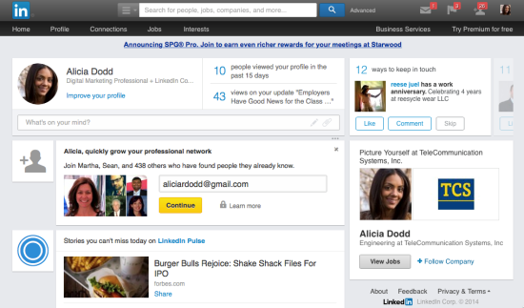
Setting up your profile: Tutorial
LinkedIn is a website dedicated to networking and advertising yourself as a professional in your industry, so consider LinkedIn your online portfolio.
Navigate yourself to the profile section of the website and the LinkedIn tutorial will walk you through the website features step by step to set up your account.
You will see many areas that you can add information that you could not on a traditional resume

Slide 5
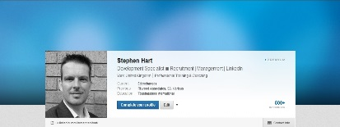
Setting up your profile: Initial Content
Here you can begin by adding various details of your professional life such as your work history.
Your work history should be added chronologically or in the same format your professional resume appears.
You can begin by adding the information directly from your resume, but you can add so much more!
LinkedIn allows you more freedom and space to go into detail, add media, and upload projects you have worked on.

Slide 6
Setting up your profile: Extra Content
Add a professional picture to make yourself easily recognizable, consider investing in professional photographer to keep your profile competitive with other candidate's.
Add volunteer experience in your profile, explain in detail your role and duties in your volunteer work.
This cannot be always be explained in a resume, so it is important to elaborate on this work in your LinkedIn. Employers always value volunteer and community engagement work.
Add the skills and experiences you possess to better sell yourself, these can then be endorsed by your connections to give you an edge
Pro tip: Skills that you put on your profile are inserted directly into job openings you apply to on LinkedIn, so a recruiter can see how many skills you have listed that match the skills required by the position.

Slide 7
Setting up your profile: Extra Content
You can add courses that pertain to your career as further examples that have helped you excel, on your profile.
Pro tip: Did you know LinkedIn offers courses directly through the website? You can get certified in different areas just by taking web courses offered on LinkedIn! Then add these to your profile, and become more marketable.
Additional details can be your interests, add areas you have passion outside if your work, employers look at these as well to see if you will be a good culture fit for their company.
You also add contact information to advise how LinkedIn professionals can contact you. Very important if you are seeking new opportunities.
Put your professional email address, as well as an updated number
Ensure you have a voicemail that is professional

Slide 8
The Power of Your Connections
Your connections are more than just people you know, they are professional acquaintances that may one day be your reference, or even your employer.
Add business professionals that line up with the direction you in-vision your career projection.
Add individuals who may be able to assist you professionally. You may add individuals you do not know, but ensure you add a message when requesting them, letting them know why you wish to connect.
The more connections you have, the more credit you have in your professional brand, however, do not add individuals for the sake of pure numbers; quality over quantity
Pro tip: From now on, every time you meet someone new in your professional world, add them on LinkedIn after you speak with them!

Slide 9
LinkedIn Do’s and Don'ts
Do use a professional picture for your profile, Do not use selfie’s
Don’t use LinkedIn as a dating site, keep it professional
Do be active and endorse and recommend your peers!
Don’t write inappropriately or slang terms in your correspondence over LinkedIn
Do InMail people with honest questions about positons or experiences in the industry or company you are interested in
Don’t repeatedly request or InMail individuals who do not accept/respond to you
Do share photos of your work and experiences in your industry
Don’t use LinkedIn as platform to share irrelevant or opinionated content

Slide 10
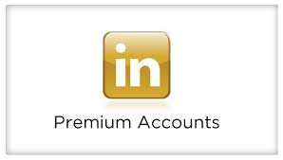
Investing in LinkedIn Premium
Premium accounts ($29.99/month) on LinkedIn are beneficial for many reasons:
You can directly InMail recruiters and hiring managers without having to be connected first.
Your profile immediately gets put to the top of the list on any applications you put in through LinkedIn.
Your profile becomes more visible to searches associated with your position title.
You can see how you “stack up” against the competition on your applications.
Premium allows you to see the company growth and the connections you know who already work there.
Did you know that Veterans can have a year of LinkedIn premium for free?
Get the most out of your experience with a premium account.
It is an investment in your future, and can lead to a job offer!
For information regarding a premium account speak with your assigned Business Development Associate.

Slide 11
U.S.VETS Career Network
LinkedIn Building 101
We hope this assisted you in building a strong LinkedIn! For more in-depth assistance, contact your Career Counselor and schedule a resume editing appointment

