Slide 1
U.S.VETS Career Network
Value Proposition 101
This tutorial will assist you in understanding the basic fundamentals of a Value Proposition, and give you a brief overview on how to build a proposition or strengthen your existing value proposition.

Slide 2
What is a Value Proposition?
A value proposition is a pitch that individuals in companies use to sale a product or service.
It can also be called an “Elevator Pitch” and it is the first impression you make in a professional environment.
The statement normally covers how the product, individual or service will add value to the company.
It is designed to be short, clear, and to the point. As if you are tuck in an elevator and have 30 seconds to make a first impression with a potential employer.

Slide 3
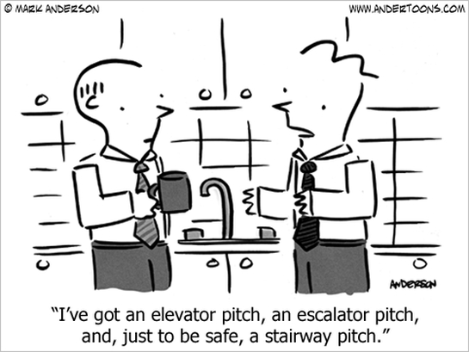
Translating your KSAs into a Value Proposition
KSA’s stand for Knowledge, Skills, and Abilities
Companies hire individuals they believe will bring added value to their organization.
The added value can be demonstrated through certain knowledge, skills, and abilities.
These details are an individual’s communicated marketable skill sets.
When communicating your Value Proposition, incorporate these details into what you say to an employer or peer.

Slide 4
When should a Value Proposition be used and why?
When you first enter into an interview
When an employer asks you to tell them about yourself
Professional networking events
When you meet any recruiter, peer, or professional in a networking environment
Social Events and Mixers
It is a great way to quickly communicate who you are, and why you’re there.
It can be altered to be more formal or less formal, to focus one education or experience or how you relate to the event.
University or Education events
You never know if a fellow student or teacher will one day be your reference or even your employer.

Slide 5
The Anatomy of a Value Proposition:
Who you are
Simple, accreditations or degrees
Your past education/Experience
As it relates, do not have a laundry list, but hit on a few key points
A success or impact you have achieved in that work, the work you do that will make you an asset
This is your chance to brag! Use quantifiable
Specific expertise and skills you have developed in your experiences
What you intend to do/contribute to a company in the future. Or, how you intent to develop professionally.

Slide 6
My name is _____ and I am a _______________ [highlight educational background]
Currently I am_______ [ Highlight current work/ volunteer experience]
and I have recently expanded my professional work to include/ or highlight your current work efforts _______________ [work you are seeking, areas to move into - i.e., human behavior and engagement in the workplace, EAP program development, Wellness etc.],
drawing upon the skills I have developed in __________ [types of skills - i.e., facilitation, training, business systems management, through prior experiences in work, volunteer positions, and internships - i.e., in counseling and program development in my prior work and placements].
In addition, I have a unique expertise in ___________ [very specific area of expertise you declare through personal research, presentations, or specific experiences - i.e., the needs of LGBQT individuals in the workplace, older workers, depression in the workplace].

Slide 7
Sample Value Proposition
Good Afternoon. My name is Chanise Simms Robinson and I am a business Development Associate at U.S.VETS. Prior to my role, I attended USC where I obtained my masters in social work and a concentration in Business.
Currently, at U.S.VETS I partner with several community partners and executive level recruiters to assist veterans in the southern California region with career placement and training.
Some of the strategic partnerships I have built include USC, Pepperdine University, Cedar Sinai, Kaiser, Fox Studios and U.S. Chamber of commerce, which have allowed my team and I to place 272 veterans in jobs for the 2016.
In addition, I hope to expand my business development and outreach efforts on a national level to strengthen company and corporations diversity and inclusion program.

Slide 8
U.S.VETS Career Network
Value Proposition 101
We hope this assisted you in building a strong Value Proposition! For more in-depth assistance, contact your Career Counselor and schedule a Value Proposition editing appointment

